Slide 1
UK Productivity Analysis
Project by KangHin Lee
D-12 Data Analyst Course
16th March 2022

Slide 2
1. Introduction

Slide 3


What is productivity
$$Productivity= \frac{Labour Output}{Labour Input}$$
$$Growth rate=rate of change in productivity per year$$
Notes:
Productivity is a economic concept for measuring labour efficiency, given by the output volume per labour input. A high productivity can leads to an increasing profitability of the company/country.
Meaning we can either produce higher output with the same amount of work, or produce the same output with less labour required.
Productivity can be measured different ways, and for this analysis we will only be using output per hour worked as our definitions of productivity.
The Growth rate is the rate of change in productivity, this productivity minus last year’s productivity

Slide 4
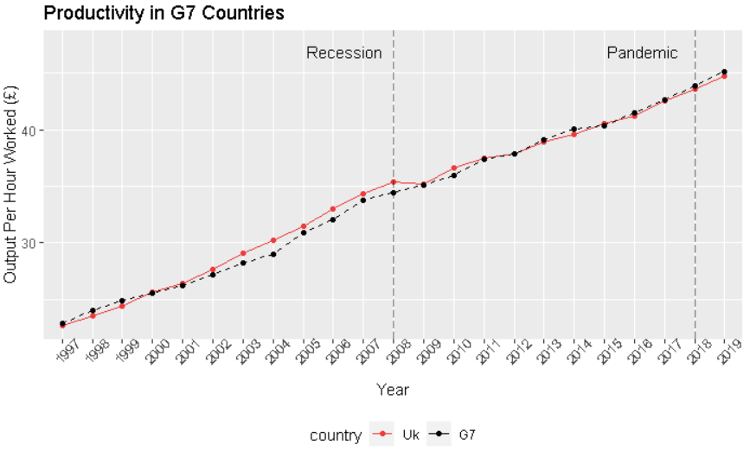
Productivity between UK & G7 Countries
Notes:
Since 2000 the UK’s productivity is always higher than the G7 countries until the great recession in 2008. Since then, the UK’s productivity has been underperformed to a point where UK’s productivity is lower than the G7 average.

Slide 5
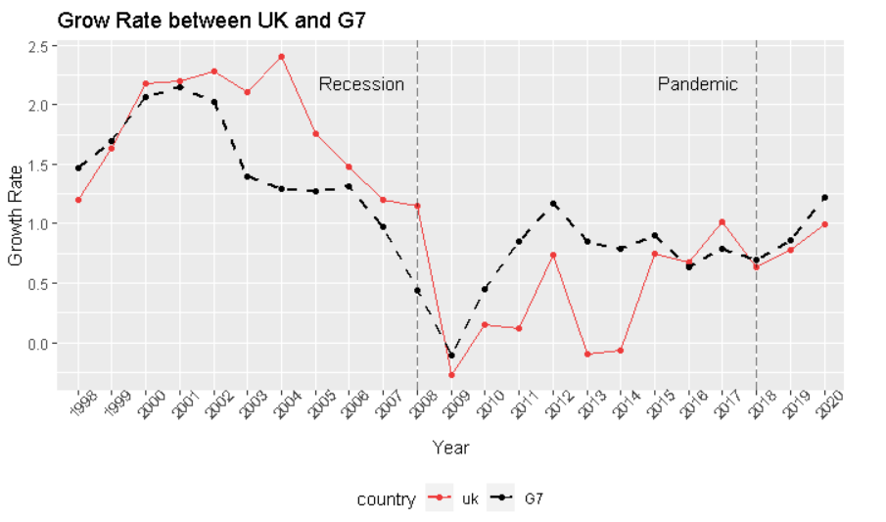
Grow Rate between UK and G7 Countries
Notes:
The underperforming characteristics can be seen in the growth rate graph. After the sharp drop in 2008, we can see the G7’s growth rate has bounced, whereas UK remained leads to an underperformed productivity.
This is the initiative for this project that we need to find ways to improve UK’s competitiveness to the market.

Slide 6
Aim of the Project
Business Question:
How can we improve productivity within Scotland and the UK overall?
MVP:
Which industries are lagging behind in terms of productivity?
What factors can be improved to increase employee and/or business productivity across UK regions?

Slide 7
2. Productivity Growth Per Industry

Slide 8
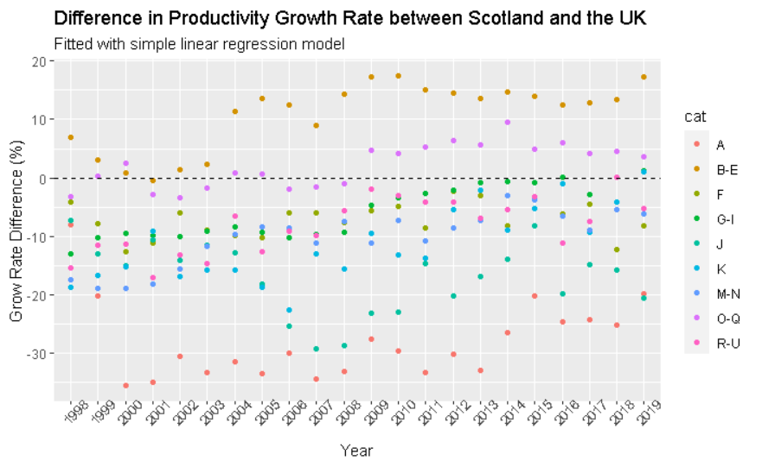
Productivity Growth Per Industry
SIC | Group Name
A | Primary Product
B-E | Engineering
F | Civil Construction
G-I | Tertiary product
J | Information and communication
K | Finance
M-N | Academic Research
Notes:
In this analysis we will be comparing how different industries perform. The industries are grouped by standard industrial classification.
The indicator that I have used is the difference in growth rate to measure the performance per industry. It indicates how fast Scottish industries are growing when compared to the UK in terms of productivty. If the data point is above 0 it means Scotland is performing better than the UK and vice versa.
I then constructed a validated linear regression model to observe the over trend of growth through the years.

Slide 9
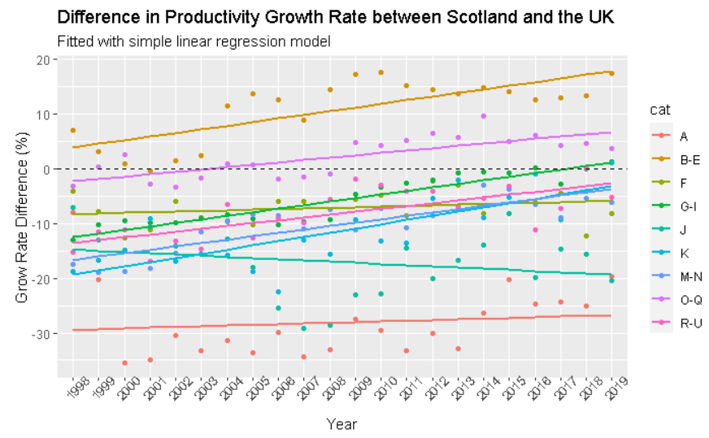
Productivity Growth Per Industry
SIC | Group Name
A | Primary Product
B-E | Engineering
F | Civil Construction
G-I | Tertiary product
J | Information and communication
K | Finance
M-N | Academic Research
Notes:
In this analysis we will be comparing how different industries perform. The industries are grouped by standard industrial classification.
The indicator that I have used is the difference in growth rate to measure the performance per industry. It indicates how fast Scottish industries are growing when compared to the UK in terms of productivty. If the data point is above 0 it means Scotland is performing better than the UK and vice versa.
I then constructed a validated linear regression model to observe the over trend of growth through the years.

Slide 10
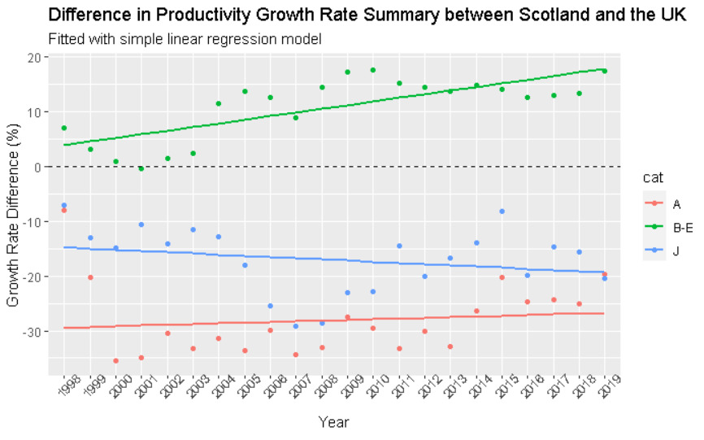
Productivity Growth Per Industry
SIC | Category Name
A | Primary Product
B-E | Engineering
J | Information and communication
Notes:
The best performed Scottish industry is engineering, with the data points laying above the margin with a positive gradient. Meaning the industry is always perform better than the rest of the UK and will be better throughout the years.
Primary Product Industry in red, has the highest negative margin, meaning the productivity growth is always slower than the rest of the UK, however, the positive gradient indicates the industry is slowing catching up.
Out of all industries, only group J, Information and communication group, has a negative margin whilst having a negative gradient, indicating the industry is declining throughout the year.
A similar analysis was carried out comparing UK and G7 countries. However, stat showed that the analysis was insignificant with an irrelevant relationship between the regression and the data point itself. Therefore I won’t be presenting the result in this presentation.

Slide 11
3. Productivity Factors

Slide 12
Productivity Factors
Hypothesis Test:
2 Samples Independent tests
5% Confidence Level
Dataset contains OECD countries
UK Standard as a reference
Economic Factors:
Inflation rate
Annual hours worked
Average / Minimum salary
Education proportion per population:-
Below Upper Secondary
Upper Secondary
Tertiary
Notes:
The second part of the analysis is aimed to find out which economic factors have influence on productivity, through conducting a series of hypothesis tests.
We have adapted 2 samples independent test, 5% confidence level.
We will be using Organisation for Economic Cooperation and Development countries (OECD) countries for the tests and UK as a reference index.
(i.e. On average, does a country with a higher salary than the UK, have a significant difference in productivity.)
Economic factors included: inflation rate, salary, total annual hours worked, and education proportion per population separated into 3 levels

Slide 13
Hypothesis Test Results
Hypothesis Test Factors | Influence on Productivity
Higher Inflation Rate | Significantly Lower
Higher Worked Hours | Significantly Lower
Higher Min/Average Salary | Significantly Higher
Upper Secondary Education | Significantly Higher
Below Upper Secondary Education | Insignificant
Tertiary Education | Insignificant
Notes:
On average, with a higher inflation rate are significantly lower productivity.
With a higher worked hours, including over time, resulted a significantly lower productivity. Deem as an inefficient way to produce output.
With a higher minimum or average salary, the productivity is significantly higher, to boost the workers’ morale.
For the 3 category of Education levels, only an increase in proportion of upper secondary education results in a significantly higher productivity, the remained 2 levels are remained insignificant on productivity.

Slide 14
Conclusion
How can we improve productivity within Scotland and the UK overall?
1. Which industries are lagging behind in terms of productivity?
Scotland’s Information and Communication Industry
2. What factors can be improved to increase employee and/or business productivity across UK regions?
On average, countries with higher Minimum / Average salary and Upper Secondary Education have significantly higher productivity.
Notes:
After the great recession in 2008, the productivity growth in the UK has been slowed down and led to a lower productivity when compared with G7 countries.
In the industry productivity analysis. We have found that Scottish’s engineering industry performed the best among the others, with a strong growth rate.
Conversely, the Scottish Information and Communication Industry showed evidence of declining in growth rate.
A series of hypothesis tests are conducted with different economics factors.
On average, higher min/avg wage and higher secondary education will result in significantly higher productivity.
With higher worked hours and inflation rate will result in a significantly lower productivity.

Slide 15
The End

Slide 17
Hypothesis Test Results
Hypothesis Test Factors | Results | Impact on Productivity
Higher Unemployment Rate | Significant | Negative
Higher Inflation Rate | Significant | Negative
Higher Worked Hours | Significant | Negative
Higher Min/Average Salary | Significant | Positive
Upper Secondary Education | Significant | Positive
Below Upper Secondary Education | Insignificant | --
Tertiary Education | Insignificant | --
Notes:
The results showed that times with a
On average, the productivity of countries with higher unemployment and inflation rate are significantly lower than countries with lower unemployment rate.
With a higher worked hours, including over time, resulted a significantly lower productivity.
To boost the works’ morale
Decouple Analysis and Confounding factors
The concluded drawn from the decoupled analysis for this project are for guidance only.
Interaction & cofounding factors are not taking into account but may affect to the labour’s productivity.
Higher min/avg wage, higher secondary education will have a high stat significant influence on the productivity.
Higher worked hours, unemployment rate and inflation rate will have a lower stat-significant influence on the productivity.

Slide 18
Industry Catagory
SIC Code | Category Name | Industries
A | Primary Product | Agriculture, forestry and fishing
B-E | Engineering | Industry (except construction)
F | Civil Construction | Construction / Civil Industry
G-I | Tertiary product | Wholesale and retail trade, transport, accommodation and food service activities
J | Information and communication | Information and communication
K | Finance | Financial and insurance activities
M-N | Academic | Professional, scientific and technical activities; administrative and support service activities

